Slide 1
Basic Html for automation
rosario, january 2019

Slide 2
agenda
What is HTML?
Tags
Nested Tags
Html Basic Structure
Head
Body
Headers
Html common tags (By Category)
Block elements AND Inline elements
Attributes
HTML 5
references

Slide 3
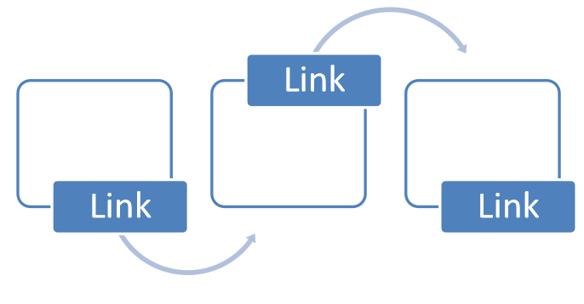
What is HTML?
Hyper Text Markup Language
Is the standard markup language for creating web pages and web applications. With Cascading Style Sheets (CSS) and JavaScript, it forms a triad of cornerstone technologies for the World Wide Web.
Web browsers receive HTML documents from a web server or from local storage and render the documents into multimedia web pages. HTML describes the structure of a web page semantically and originally included cues for the appearance of the document.

Slide 4
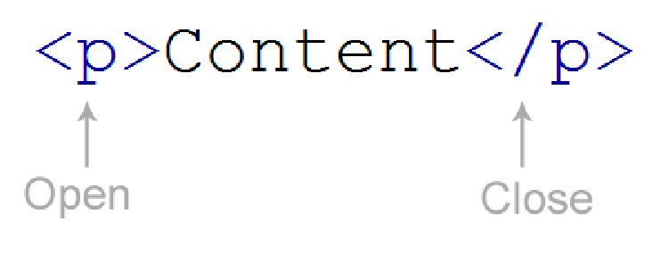
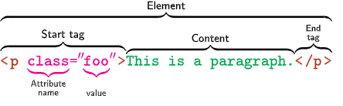
What does HTML Tag mean?
An HTML tag is commonly defined as a set of characters constituting a formatted command for a Web page. At the core of HTML, tags provide the directions or recipes for the visual content that one sees on the Web.
In the HTML syntax, most elements are written with a start tag and an end tag, with the content in between. An HTML tag is composed of the name of the element, surrounded by angle brackets. An end tag also has a slash after the opening angle bracket, to distinguish it from the start tag

Slide 5
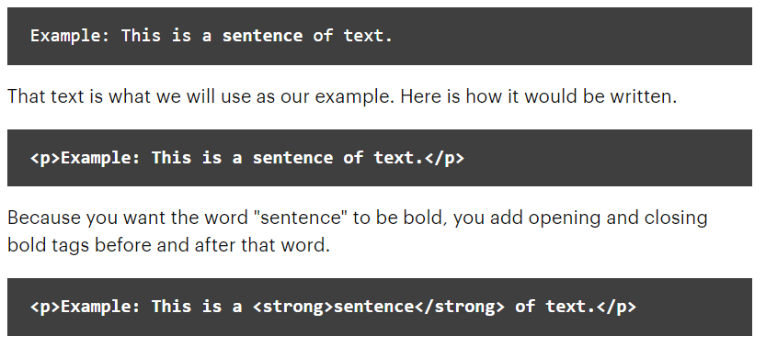
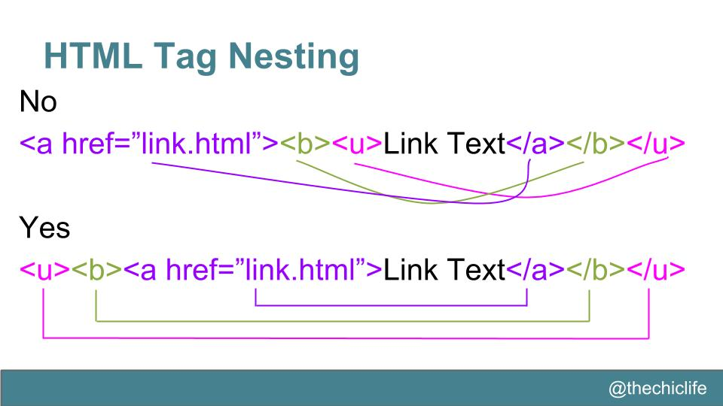
Nested Tags
What Does It Mean to Nest HTML Tags?
The easiest way to understand nesting is to think of HTML tags as boxes that hold your content. Your content can include text, images, etc. HTML tags are the boxes around the content. Sometimes, you need to places boxes inside of other boxes. Those "inner" boxes are nested inside of others.
If you have a block of text that you want bold inside a paragraph, you'll have two HTML elements as well as the text itself.

Slide 6
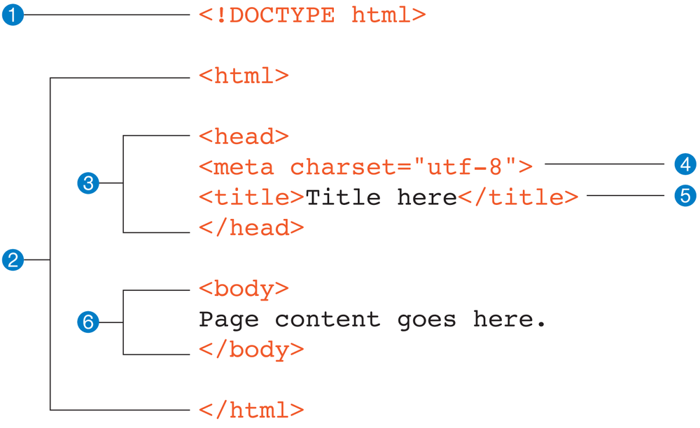
HTML Basic Structure
It is a document type declaration (also called DOCTYPE declaration) that identifies this document as an HTML5 document
The entire document is contained within an html element. The html element is called the root element because it contains all the elements in the document, and it may not be contained within any other element. It is used for both HTML and XHTML documents.
Within the html element, the document is divided into a head and a body. The head element contains descriptive information about the document itself, such as its title, the style sheet(s) it uses, scripts, and other types of “meta” information.
The meta elements within the head element provide information about the document itself. A meta element can be used to provide all sorts of information, but in this case, it specifies the character encoding (the standardized collection of letters, numbers, and symbols) used in the document.
in the head is the mandatory title element. According to the HTML specification, every document must contain a descriptive title.
Finally, the body element contains everything that we want to show up in the browser window.

Slide 7
Html common tags (By Category)
Basic HTML
<!DOCTYPE>, <html>, <head>, <title> and <body>
<h1> to <h6> Defines HTML headings
<p> Defines a paragraph
<br> Insert a single line break
Formatting
Forms and Input
<form> Defines an HTML form for user input
<input> Defines an input control
<textarea> Defines a multiline input control (text area)
<button> Defines a clickable button
<select> Defines a drop-down list
<label> Defines a label for an <input> element
Frames
Images
<img> Defines an image
<area> Defines an area inside an image-map
Audio / Video

Slide 8
Html common tags Cont…
Links
<a> Defines a hyperlink
<link> Defines the relationship between a document and an external resource (most used to link to style sheets)<nav> Defines navigation links
Lists
<ul> Defines an unordered list
<ol> Defines an ordered list
<li> Defines a list item
Tables
<table> Defines a table
<th> Defines a header cell in a table
<tr> Defines a row in a table
<td> Defines a cell in a table
Styles and Semantics
<style> Defines style information for a document
<div> Defines a section in a document
<span> Defines a section in a document
Meta Info
Programming
<script> Defines a client-side script
SEE MORE REFERENCES ON W3CSCOOLS.COM

Slide 9
Block elements AND Inline elements
BLOCK
INLINE
A block-level element always starts on a new line and takes up the full width available (stretches out to the left and right as far as it can).
The <div> element is a block-level element.
An inline element does not start on a new line and only takes up as much width as necessary.
This is an inline <span> element inside a paragraph.
EXAMPLES
TEXT

Slide 10
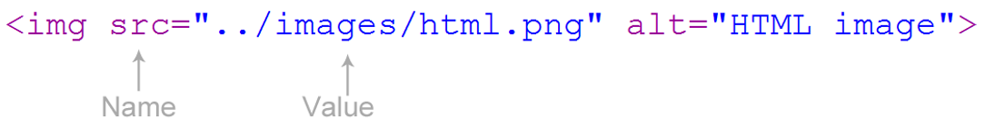
Attributes
What does attributes means?
HTML Attributes
Attributes provide additional information about HTML elements.
All HTML elements can have attributes
Attributes provide additional information about an element
Attributes are always specified in the start tag
Attributes usually come in name/value pairs like: name="value"
EXAMPLES

Slide 11

HTML5
What about html5
HTML 5 (formerly and commonly spelled HTML5^{[a]}) is a software solution stack that defines the properties and behaviors of web page content by implementing a markup based pattern to it.
HTML 5 is the fifth and current major version of the HTML standard, and subsumes XHTML. It currently exists in two standardized forms: HTML 5.2
SEE MORE REFERENCES

Slide 12
references
https://www.w3schools.com/
https://www.espace.cool/
https://www.wikipedia.org/
https://developer.mozilla.org

Slide 13
Adelquis trinidad
engineer
adelquis.Trinidad@endava.com

